Slide 1
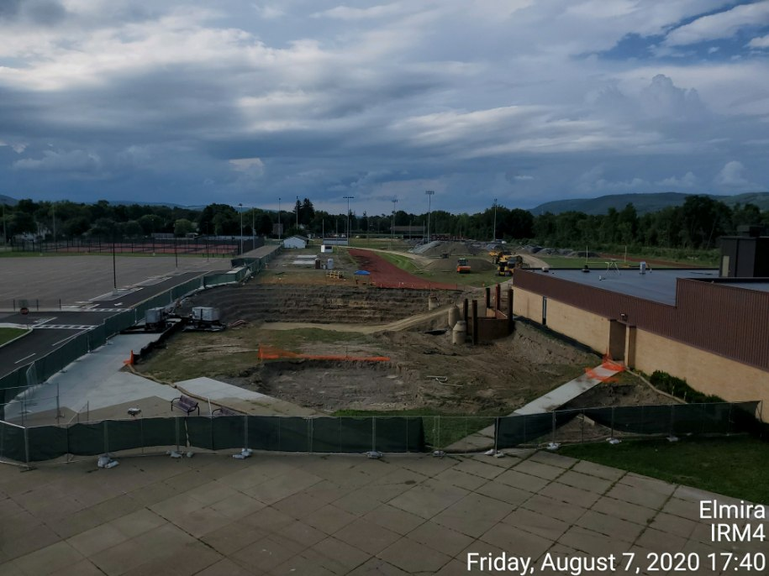
Summary of Soil Removal Interim Remedial Measures
Former Sperry Remington Site at Elmira High School
NYSDEC ID #C808022
Public Availability Session
December 2020

Slide 2
Soil Removal IRMs in coordination with EHS Capital Improvement Projects
Since 2017, soil removal IRMs have been designed in coordination with EHS capital improvements
Year | IRM | EHS Capital Improvement Projects
2017 | IRM #1 | Tennis Courts and Student/Faculty Parking Lot
2018 | IRM #2 | Rear Staff Parking Lot
2019 | IRM #3
2020 | IRM #4
 | IRM #5
Stadium Improvements (planned for 2021)
Learn more about Elmira High School’s Stadium Renovation Project:
https://www.elmiracityschools.com/news/what_s_new/new__elmira_high_school_stadium

Slide 3
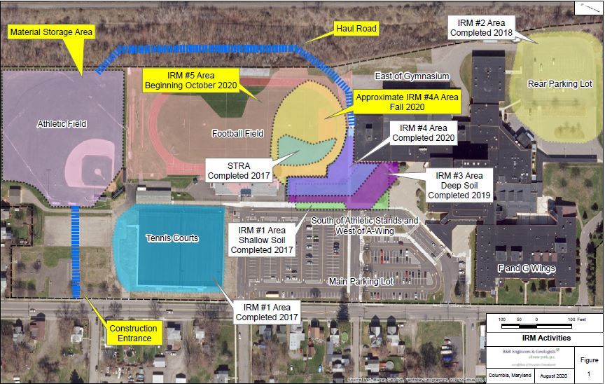
IRM # 6 - 2021
IRM # 6 - 2021
IRM # 5 – December 2020

Slide 4
Soil Removal IRM Scope
Excavation to remove soils with contamination above IRM action levels
Off-site disposal of hazardous and non-hazardous waste
Backfilling with demarcation layers and approved fill
Site restoration with final cover
  Turf
  Concrete
  Asphalt
Turf Cover System Following Excavation

Slide 5
IRMs by the numbers
IRM #1 (June to September 2017) | IRM #2 (June to September 2018) | IRM #3 (June to September 2019) | IRM #4 (June to August 2020)
6,805 cubic yards of soil excavated 1,350 tons disposed off-Site as hazardous waste 2,580 tons disposed off-Site as non-hazardous waste 500 cubic yards of soil reused as backfill below demarcation layer 11,580 tons of fill imported for backfill and soil cover | 16,050 cubic yards of soil excavated 12,951 tons disposed off-Site as hazardous waste 16,507 tons disposed off-Site as non-hazardous waste 8,100 cubic yards of soil reused as backfill below demarcation layer 22,834 tons of fill imported for backfill and soil cover | 11,545 cubic yards of soil excavated 8,250 tons disposed off-Site as hazardous waste 3,268 tons disposed off-Site as non-hazardous waste 4,963 cubic yards of soil reused as backfill below demarcation layer 14,099 tons of fill imported for backfill and soil cover | 6,500 cubic yards of soil excavated 4,079 tons disposed off-Site as hazardous waste 3,977 tons disposed off-Site as non-hazardous waste 1,987 cubic yards of soil reused as backfill below demarcation layer 7,993 tons of fill imported for backfill and soil cover
Note: excavation measurements are cubic yards (cy) and disposal is measured as tons. For this site the conversion is 1 cy = 1.9 ton

