Slide 1
New York State Department of Health’s
Role at Elmira High School
Work with NYSDEC to identify nature and extent of contamination to evaluate potential exposures
Evaluate data and make recommendations to address any potential exposure and evaluate the need for additional information
Ensure that remedy selected is protective of public health

Slide 2
What is exposure?
Physical contact with a chemical or substance
    Inhalation (breathing)
    Direct contact (touching)
    Ingestion (eating/drinking)
    One or more of these physical contacts must occur before a chemical has the potential to cause a health problem
    Exposure does not necessarily mean that health effects will occur

Slide 3
Potential exposure pathways
Inhalation
Contaminated Soil Vapor (air beneath the building): Volatile Organic Compounds - Trichloroethylene (TCE), Tetrachloroethylene (PCE), Freon12
Potential release of contaminated dust to the outdoor air during interim remedial activities (IRM) and construction.
Provisions are in place to protect the school community and address these potential exposure pathways as described on the following slides.

Slide 4
Soil Vapor Intrusion
Soil vapor intrusion refers to the process by which volatile chemicals (VOCs) move from a subsurface source into the indoor air of overlying buildings.
Soil Vapor Intrusion Sampling Results:
  Sub-Slab: VOCs above screening levels beneath the building
  Indoor Air: VOCs historically detected below applicable NYSDOH air guidelines
  Exposures to site-related VOCs in indoor air are currently eliminated through continuous operation of sub-slab depressurization systems.

Slide 5
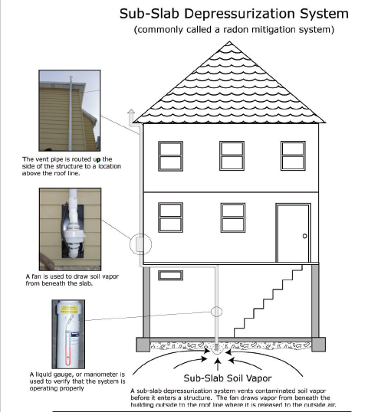
Sub-Slab Depressurization System (SSDS)
A sub-slab depressurization system, much like a radon mitigation system, essentially prevents vapors beneath a slab from entering a building. A low amount of suction is applied below the foundation of the building and the vapors are vented to the outside.
The SSDS at Elmira High School is monitored under the Interim Site Management Plan (ISMP) and inspected quarterly. Indoor air quality is monitored annually.

Slide 6
Potential inhalation exposure during IRMs
Community Air Monitoring Plan – Protects the school community by continuously monitoring the air for dust and PCBs during IRMs and construction activities.
PCB Air Monitor Dust Monitor
Engineering controls will be in place to minimize dust generation and prevent access to the work area. These include silt fencing, watering of excavations/soil, covering of stockpiled soils as well as other best practices to reduce migration of contaminated materials.

Slide 7
Potential Exposure Pathways
Direct Contact
Impacts to Soil: Polychlorinated Biphenyls (PCBs), Metals, Semi-Volatile Organic Compounds (SVOCs), Volatile Organic Compounds (VOCs)
  It is unlikely that people will come into contact with contaminants in on-site soil unless they dig below the ground surface.
  Contaminated soil is covered, therefore direct contact is not occurring. Plans are in place to maintain the cover and there are procedures for proper handling of soils that are disturbed to prevent exposures.

Slide 8
Potential Exposure Pathways
Ingestion
Impacts to Groundwater: Volatile Organic Compounds (VOCs), Metals
People are not drinking contaminated groundwater as the area is served by a public water supply that is not affected by this contamination.

Slide 9
How are exposures being addressed?
The interim remedial measures are removing soil that is known to be contaminated from the site. The Community Air Monitoring Plan (CAMP) is active during all soil removal activities to minimize exposure.
Interim Site Management Plan includes monitoring of protective cover systems, SSDS operation and soil disturbances. Inspections of the building for floor cracks, SSDS operation and cover systems are done quarterly.
Potential exposure pathways are re-evaluated whenever new information become available or conditions change.

