Slide 1
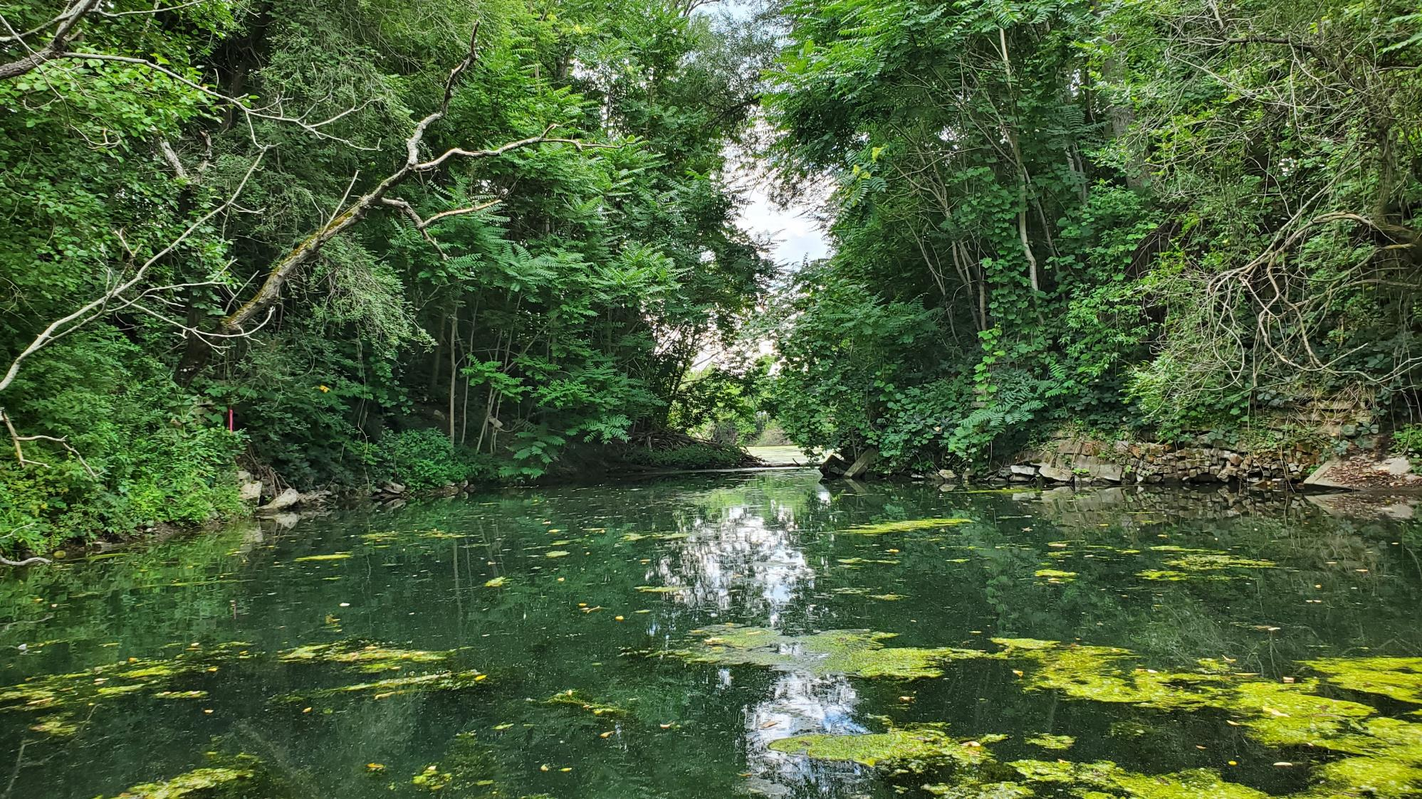
Update on Remedial Investigation Activities Along Coldbrook Creek
Former Sperry Remington Off-site Area – Coldbrook Creek
NYSDEC ID # C808043
Public Availability Session
December 2020
Coldbrook Creek

Slide 2
Off-Site Remedial Investigation Objectives
Delineate the nature and extent of contamination from the site and flood prone overbank soils.
Evaluate potential human health exposure risks and remedial clean-up options.
Evaluate potential risks or impacts to the Coldbrook Creek ecosystem.

Slide 3
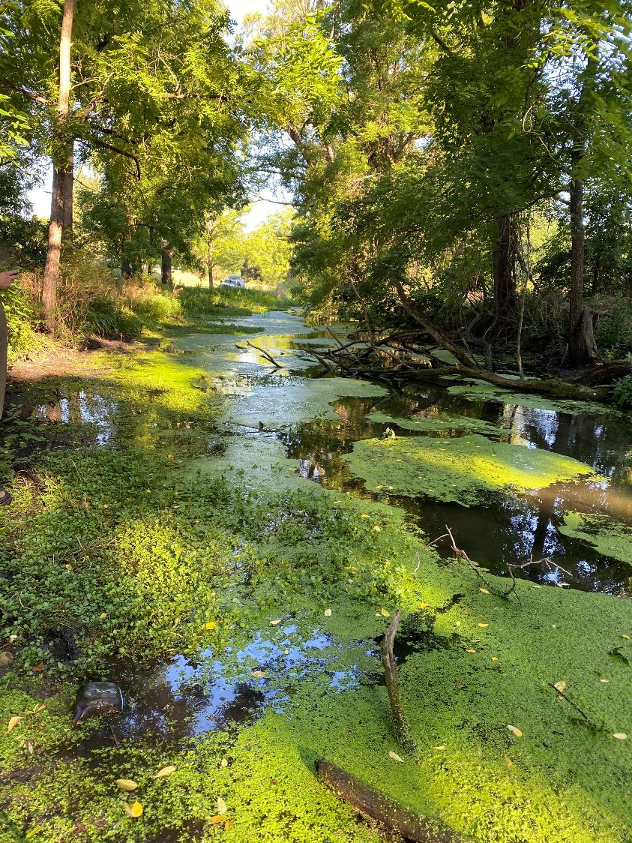
Coldbrook Creek Background
Site headwaters former industrial history
1887 – 1909: B. W. Payne & Sons, manufacturer of high-speed steam engines;
1909 – 1935: Morrow Manufacturing, manufacturer of drill chucks, machine parts and tools;
1935 – 1937: Elmira Precision Tool Company, manufacturer of typewriter parts for Remington Rand;
1936 – 1972: Remington Rand, manufacturer of typewriters and adding machines;
1974 – 1977: Westinghouse Electric Corporation occupied approximately ten (10) acres of the EHS property south of the City of Elmira-Town of Southport line, primarily for warehousing.
Historically, Coldbrook Creek received industrial discharge from these listed former industrial uses
Currently, Coldbrook Creek receives stormwater runoff from City of Elmira/Town of Southport, STCC, permitted discharge of non-contact cooling water from Elmira High School, and stormwater discharge from Miller Pond (connected in 1940s)
Coldbrook Creek flows approximately 2.6 miles, where it forms a confluence with the Chemung River
Fish tissue collection in Coldbrook Creek

Slide 4
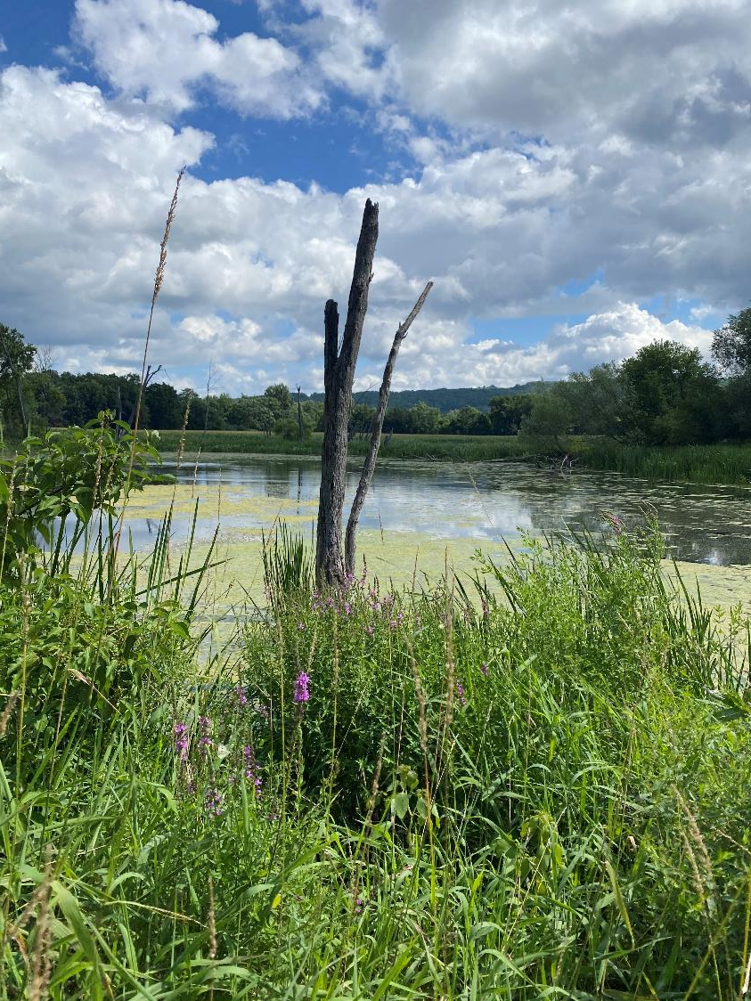
RI Background
The RI includes investigating the nature and extent of contamination in and along Coldbrook Creek including:
Wetlands and drainage swale sediment
Creek and backwater sediment
Surface water
Floodplain (overbank) deposits
Former channel alignment deposits
The RI has been conducted over a series of sampling events including:
Sediment samples collected 2011-2015 and 2020
Overbank soil samples collected 2011-2015, 2019 and 2020
Fish tissue collection in Coldbrook Creek

Slide 5
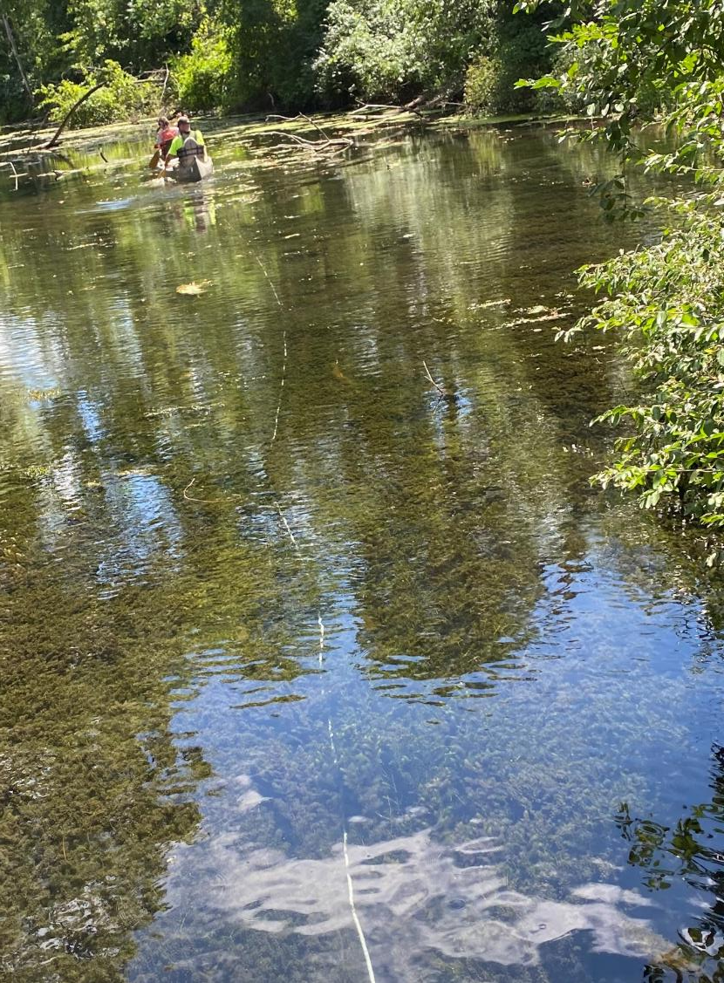
Coldbrook Creek Investigation
Coldbrook Creek Study Area Evaluation
Instream Sample Collection – sediment chemistry, biota (fish tissue), sediment toxicology, benthic community survey
Overbank Sample Collection – composite and discrete soil along 2.6 miles of Coldbrook Creek
Sample Collection
203 Sediment samples collected 2011-2015
166 Overbank soil samples collected 2011-2015
160 Overbank composite soil samples collected 2019
208 Sediment samples collected 2020 (on-going)
24 Benthic community surveys completed 2020 (on-going)
60 Fish tissue samples collected 2020 (on-going)
318 Overbank composite and discrete soil samples collected 2020 (on-going)
Fish tissue collection in Coldbrook Creek

Slide 6
Summary of 2020 Field Data Collection
Catherine Creek
Phase II Overbank Soil Sampling
Composite soil collection and discrete delineation soil collection
July 28 – August 18
318 soil samples submitted for chemistry analysis
Ecological Risk Assessment
Sediment chemistry, toxicology testing, benthic community survey, fish tissue sample collection
Reference creek samples collected for comparison (Catherine Creek)
July 28 – August 12
208 sediment and 60 fish tissue samples submitted
24 benthic community surveys and toxicity tests completed

Slide 7
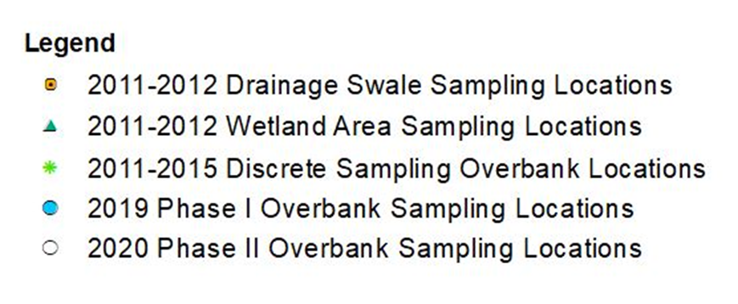
Overview map of remedial investigation area of Coldbrook Creek.

Slide 8
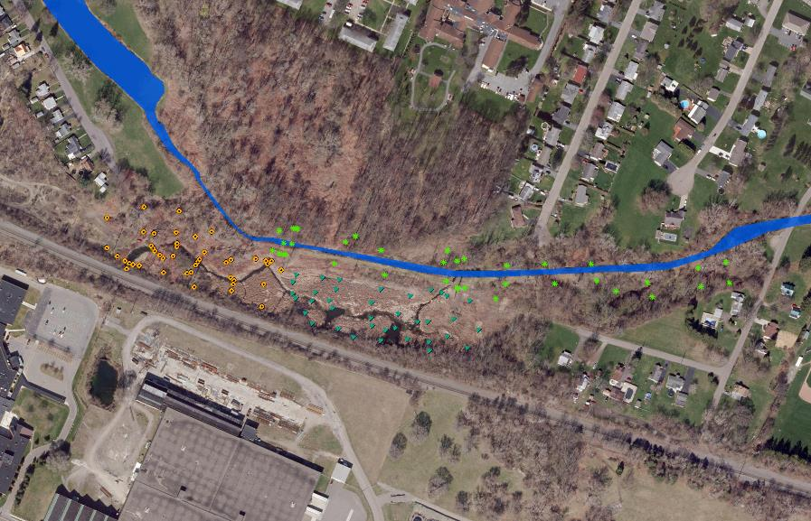
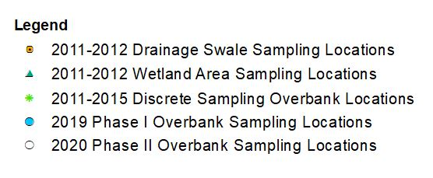
Before current remedial investigation efforts of Coldbrook Creek, various soil and sediment sampling was conducted between 2011 and 2015. A total of 369 samples were collected.

Slide 9
Coldbrook Creek Phase I
Overbank Sampling was conducted in potential flood plain zones in November 2019.
A total of 160 composite soil samples were collected.

Slide 10
Coldbrook Creek Phase II
Overbank Sampling was conducted in July 2020. Discrete soil samples were collected to delineate impacted areas from Phase I Overbank Sampling (2019) and collect additional composite soil samples within flood plain zone. A total of 318 soil samples were collected.

Slide 11
Phase II Overbank Evaluation Schedule
Task | Anticipated Start | Anticipated Completion
Work Plan Approval (Completed) | -- | July 2020
Field Activities (Completed) | July 2020 | August 2020
Data Analysis | August 2020 | October 2020
Phase II Evaluation & Reporting | November 2020 | December 2020
Recommendations for Further Evaluation and Necessity of Phase III Sampling | January 2021 | March 2021

Slide 12
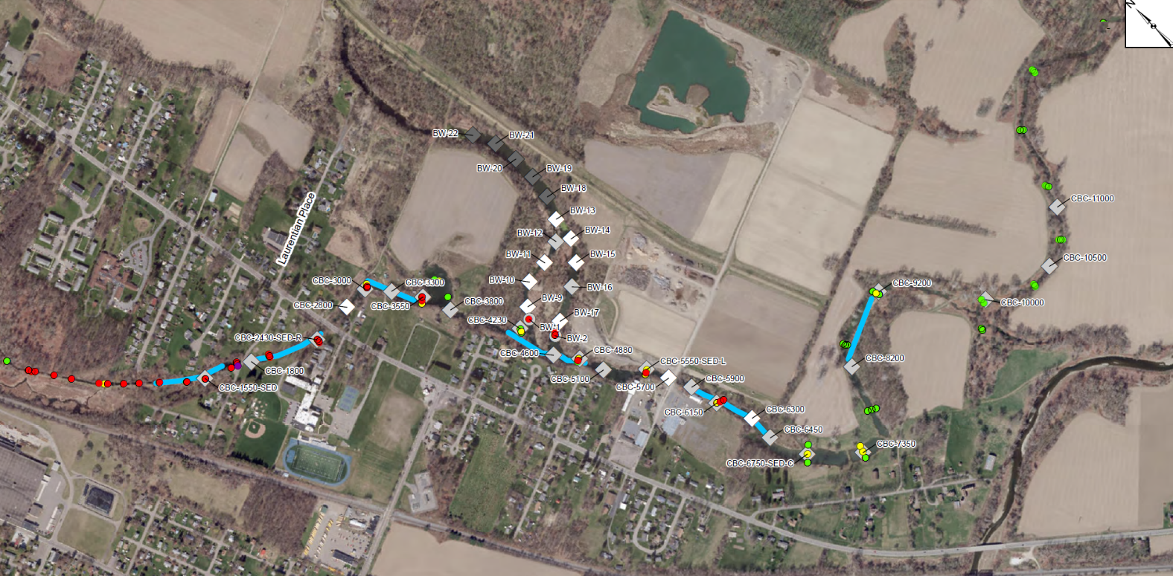
Fish & Wildlife Impact Analysis
Schedule
Task | Anticipated Start | Anticipated Completion
Work Plan Approval (Completed) | -- | June 2020
Field Activities (Completed) | July 2020 | August 2020
Data Analysis | August 2020 | January 2021
Reporting | January 2021 | August 2021

